Slide 1
A hardware trojan DETECTION TECHNIQUE BY IMPROVING TRANSITION PROBABILITIES OF THE NETS
by
ARATI SHAW
SHREYASI KARAK
SUKANYA NASKAR

Slide 2
Introduction
Any hardware circuit requires to perform some predefined functionalities. Malicious circuitry or trojan injected during fabrication or designing may infect the circuit risking the normal functionalities of the hardware.
In addition, such tampering can also lead to leakage of vital information of hardware chip to an unauthorized party.
So, trojan detection is inevitable to counter such malicious modifications of the circuit.

Slide 3
AIM OF THE PROJECT
In this project, we are emphasizing on detection of hardware portions where there could be possibility of trojan injection.
Modification of weak links of the circuit using additional hardware so that trojan cannot attack the circuit.
To reduce the vulnerability of integrated circuit.

Slide 4
Some important definitions
Trojan: A hardware trojan is a malicious tampering of certain circuitry of an integrated circuit.
Trust Hub: It is a circuit used to study the insertion of hardware trojan, it's detection, side channel analysis, vulnerability analysis etc.
Transition Probability: The probability of occurrence of a transition between two output states of a gate.
Insertion Point: Point in the circuit which is more susceptible to trojan injection.
Threshold: A benchmark for transition probability.

Slide 5
overview
In this project, we will calculate the transition probabilities of each component (gate) of the circuit.
This will help us to figure out the low transition probability gates whose output needs to be modified to incure a higher transition probability.
The gate(s) connected to most of the low transition probability gates will become the insertion point, where an additional hardware component will be added.
Then we will evaluate the modified transition probabilities.

Slide 6
algorithm to find insertion point(S)
INPUT :
Circuit Netlist
List of Low Transition Probability Nodes (L)
Trigger Threshold (P_{th} )
OUTPUT :
List of Insertion Point (L_{p})

Slide 7
algorithm to find insertion point(S)
Step 1 : For each gate in the circuit with output A(say)
Transition probability of A = signal probability of 0 * signal probability of 1
Step 2 : For each gate(i) with transition probability(TP_{i}) of the circuit :
if (TP_{i} < P_{th}) : Insert gate(i) in list(L)
Step 3: Convert the circuit into a directed graph where,
node -> gate of the circuit
incoming edges -> input to a gate
outgoing edges -> output from a gate

Slide 8
algorithm to find insertion point(S)
Step 4: Transpose the graph
Step 5: For each node in L, run depth first search and record the path
Step 6: Determine the common node(k) of all these paths with minimum depth limit and insert node(k) in L_{p}
D = depth limit of k from each node in L
d = minimum (D)

Slide 9
algorithm to find insertion point(S)
Step 7: For each node(n) in L: determine node(n_{d}) at depth d from n
if (at least one node from n_{d} is present in L_{p})
continue;
else
if(signal prob. of 0 of node(n) > signal prob. of 1 of node(n)):
select one node from n_{d} where (sp₀<sp₁) and insert in L_{p}
else if(signal prob. of 0 of node(n) < signal prob. of 1 of node(n)):
select one node from n_{d} where (sp₀>sp₁)and insert in L_{p}

Slide 10
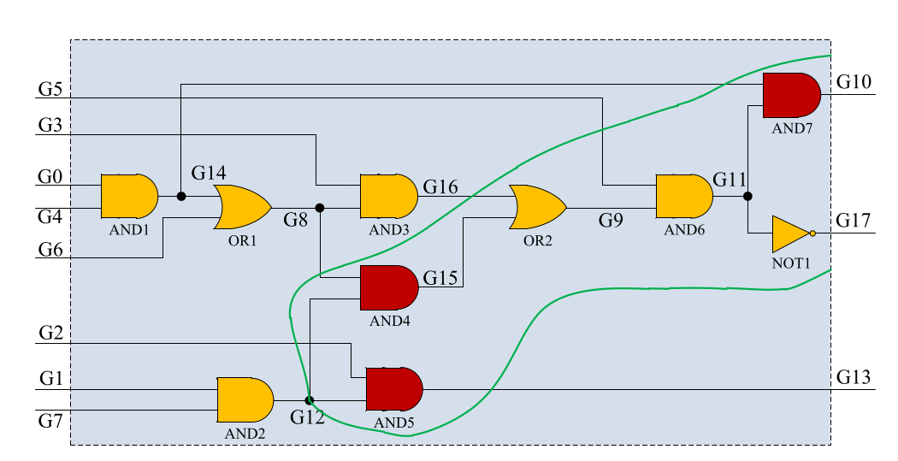
Example CIRCUIT

Slide 11
GATE NUMBER | TRANSITION PROBABILITY (SORTED ORDER)
G10 | 0.04973500967025757
G13 | 0.109375
G15 | 0.1318359375
G11 | 0.1658773422241211
G17 | 0.1658773422241211
G14 | 0.1875
G12 | 0.1875
G16 | 0.21484375
G8 | 0.234375
G9 | 0.24358749389648438
Threshold Probability : 0.15
Therefore , { G10 , G13 , G15 } are the low transition probability points.
Insertion Points : { G12 , G14 }

Slide 12
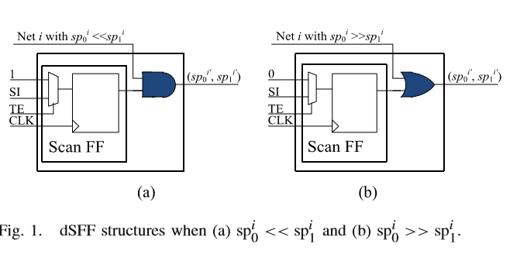
Additional hardware used

Slide 13
RESULT
GATE NUMBER | TRANSITION PROBABILITY (sorted order) | Modified TRANSITION PROBABILITY | % change in TP after adding dsFF(s)
G10 | 0.04973500967025757 | 0.1875 | 276.9980165744863
G13 | 0.109375 | 0.1875 | 71.42857142857143
G15 | 0.1318359375 | 0.234375 | 77.77777777777777
G11 | 0.1658773422241211 | 0.21185302734375 | 27.716675769684077
G17 | 0.1658773422241211 | 0.25 | 50.713772386236236
G14 | 0.1875 | 0.1875 | 0.0
G12 | 0.1875 | 0.1875 | 0.0
G16 | 0.21484375 | 0.234375 | 9.090909090909092
G8 | 0.234375 | 0.1875 | -20.0
G9 | 0.24358749389648438 | 0.238037109375 | -2.2785999530185577

Slide 14
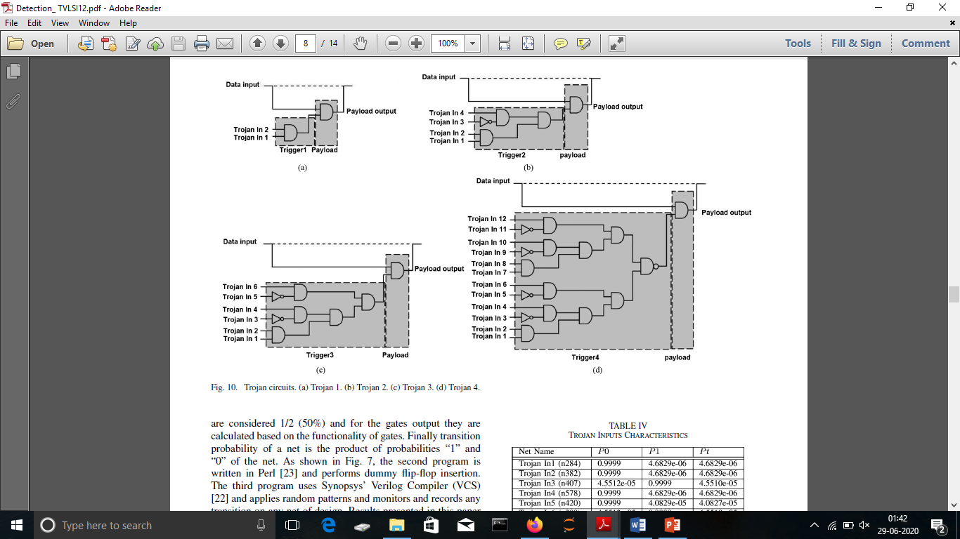
TROJAN CIRCUITS
-> Trojan Circuits are taken from [ *1 ]

Slide 15
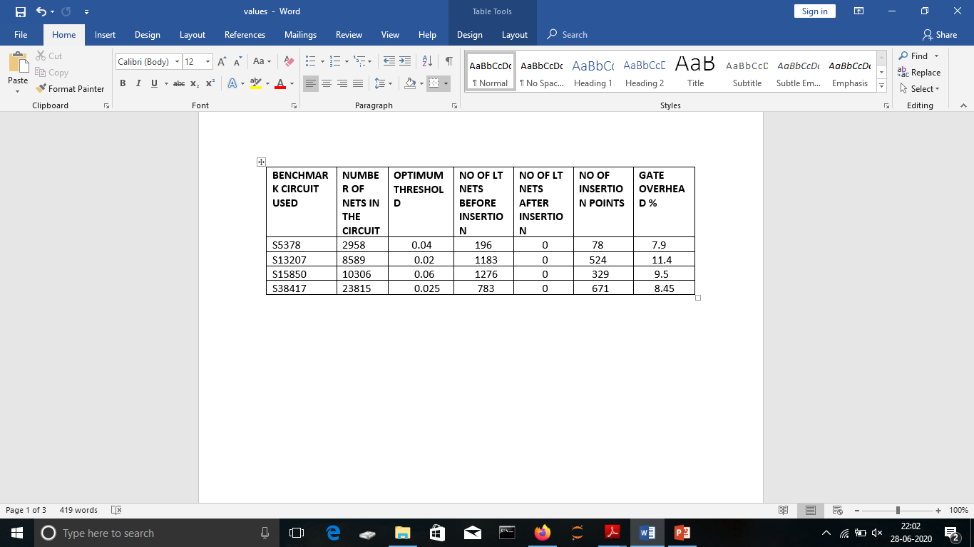
Outcome from other benchmark circuits

Slide 16
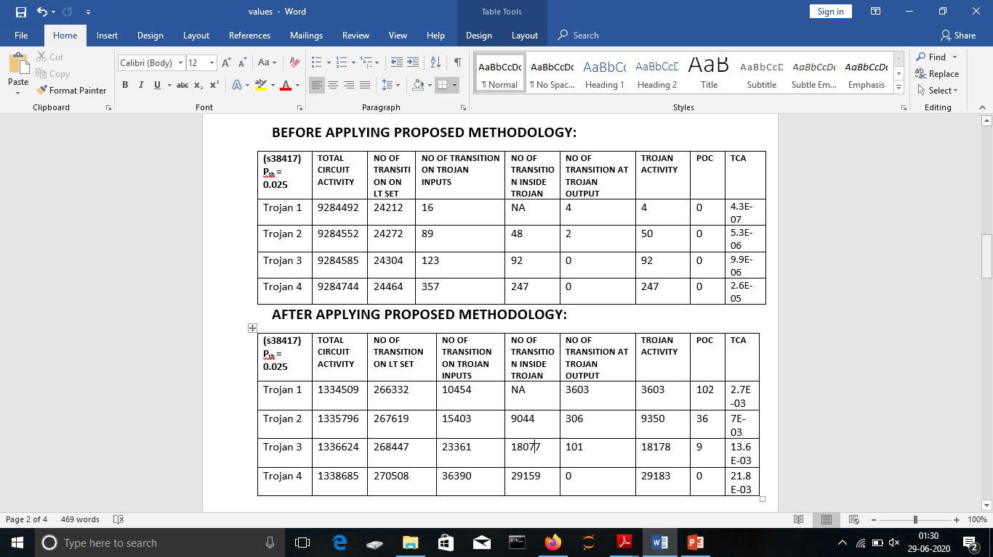
TROJAN ACTIVATION AND DETECTION ANALYSIS USING PROPOSED METHOD FOR 1000 RANDOM TEST PATTERNS

Slide 17
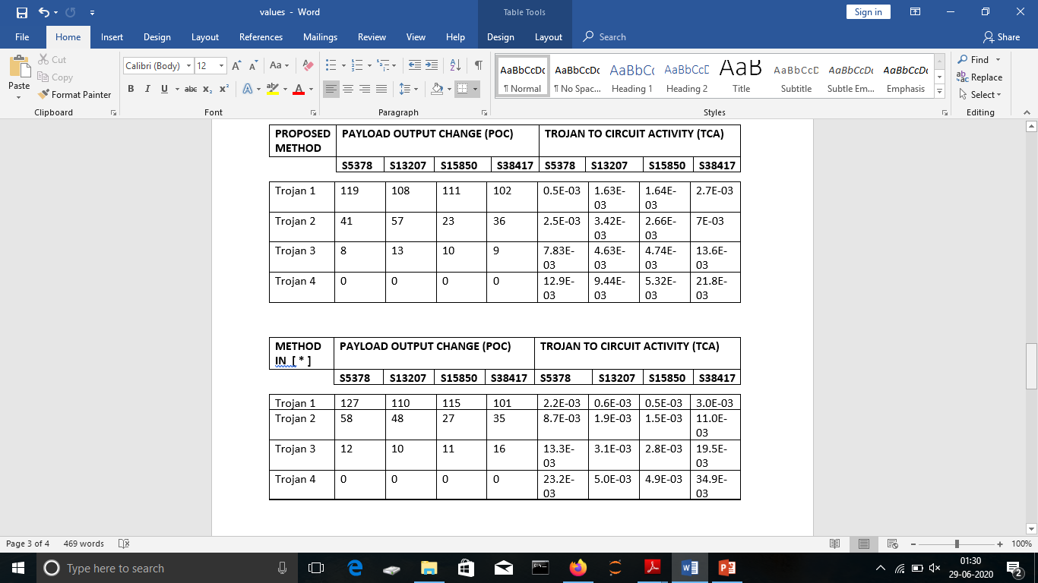
COMPARISON OF POC & TCA USING OPTIMUM THRESHOLD PROBABILITY

Slide 18
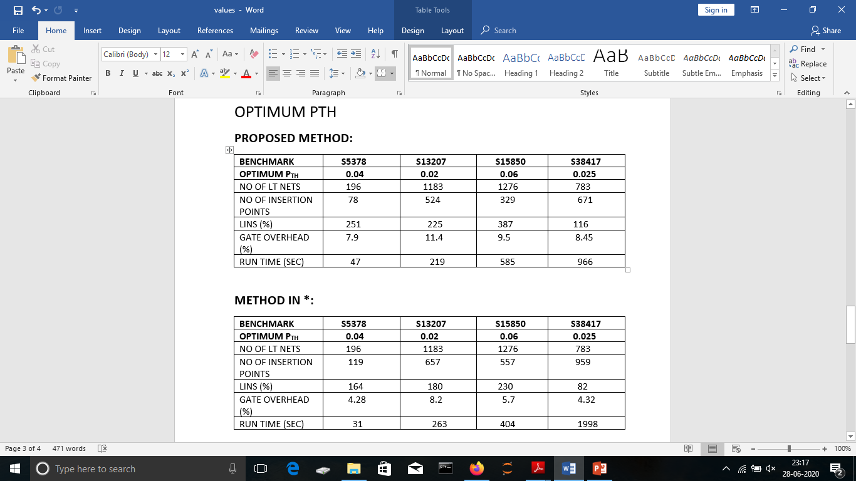
COMPARISON OF TIME COMPLEXITY AND CIRCUIT OVERHEADS USING OPTIMUM PTH

Slide 19
REFERENCES
[ * ] Ahmad Shabani and Bijan Alizadeh, “ PMTP: A MAX-SAT Based Approach to Detect Hardware Trojan Using Propagation of Maximum Transition Probability “
[ *1 ] Hassan Salmani, Mohammad Tehranipoor and Jim Plusquellic,
“A Novel Technique for Improving Hardware Trojan Detection and Reducing Trojan Activation Time “

Slide 20
conclusion
The proposed methodology is suitable to detect Trojan in hardware circuits. Using the additional hardware (dsFF) we can alter the transition probability of weak links (insertion point) of the circuit and therefore we can resist the malicious attack.
In this way, we can decrease the vulnerability of the integrated circuit chips.

Slide 21
Thank you

